Slide 1


Reaching through the screen
KARE as a scaffolding to support online education
Kate Lindsay | https://katelindsayblogs.com/ | @KTDIGITAL

Slide 2
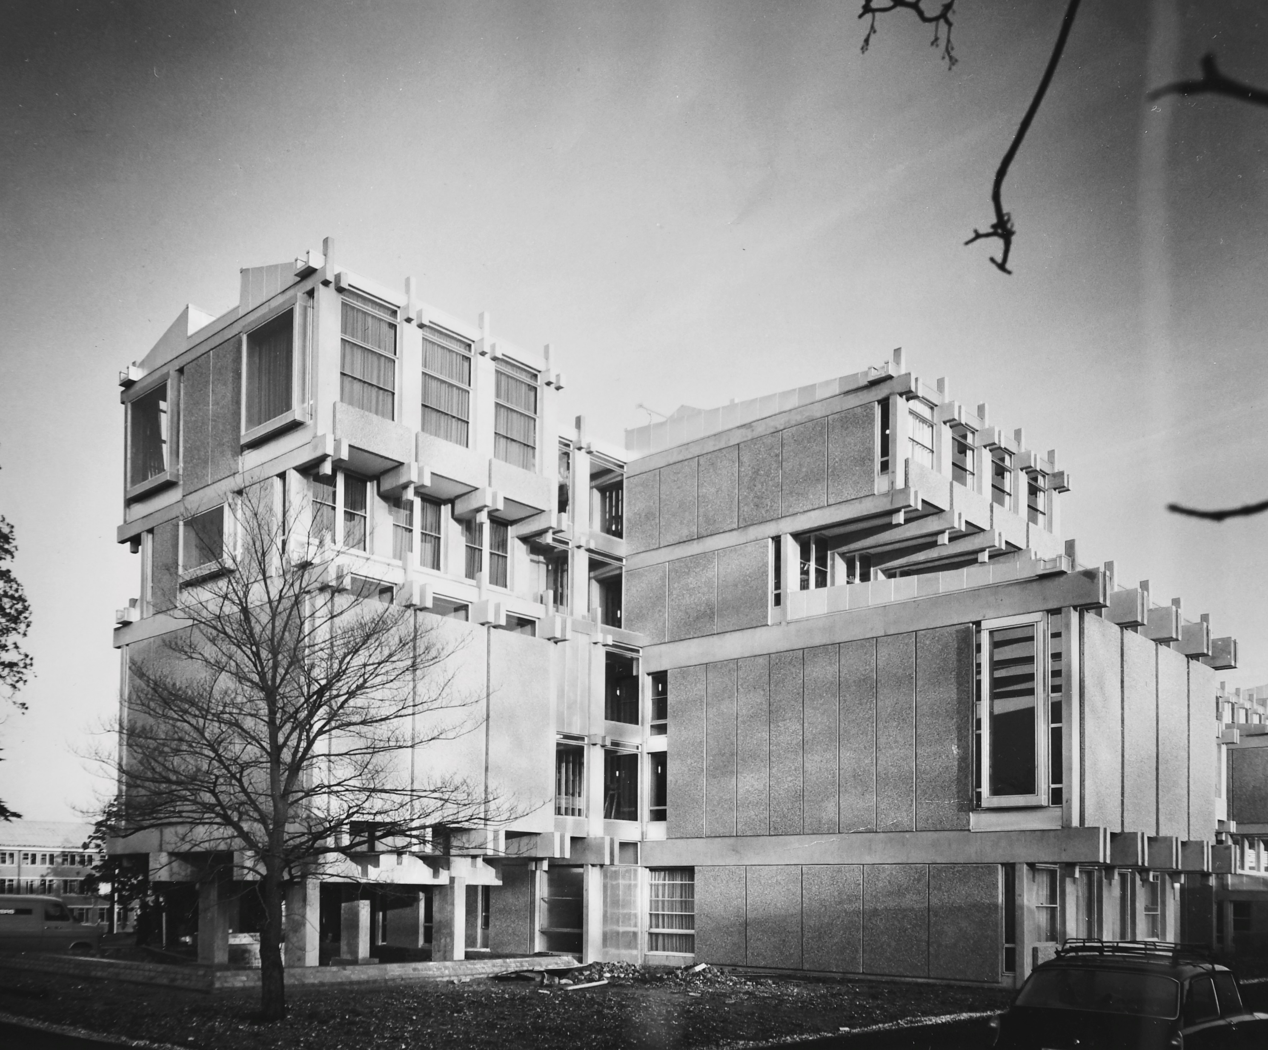

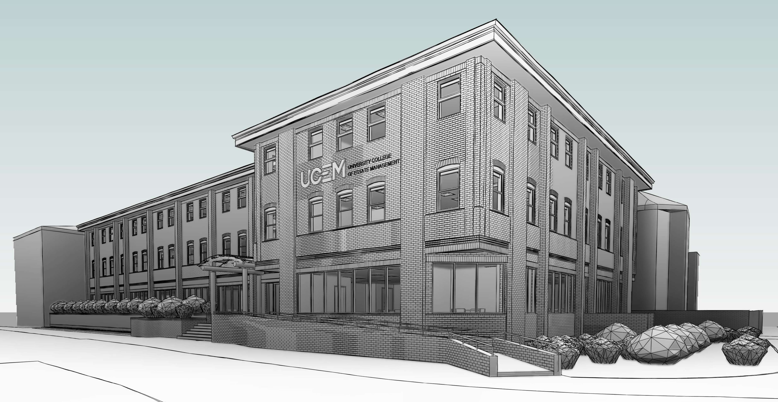
c
c
Kate Lindsay @KTDIGITAL
Notes:
The University College of Estate Management, was established in 1919. This year we are celebrating our centenary year. Origionally sited in Lincolns Fields in London the institution initially provided Free Technical Education in Real Estate and related areas for the sons of those who had been killed, disabled or impoverished in World War One amid calls for improved building standards and living conditions, including for city slums to be replaced with better quality housing
By the 1940s it was providing largely correspondence courses including in WW2 to Prisoners of War and the Womens Land Army.
In late 1960s we became associated with the University of Reading, building premises on campus and Reading validating degrees, with students studying on site and via correspondence.
In 2013 we received our own degree award powers and in 2016 left Reading Campus, with the exception of our apprenticehip programmes we are now a fully online University, offering 13 programmes of study from level 3 to level 7. Flexible.

Slide 3

Challenges
Housing supply
Sustainability
Health & wellbeing
Kate Lindsay @KTDIGITAL
Notes:
UCEM works closely with the leading professional bodies in the built environment to ensure that our programmes provide the knowledge and understanding required to achieve chartered status and approach the challenges we are facing in the industyr.
Tricky problems in the built environment sector
Housing crisis – too few homes available and those homes that are on the market being far too costly.
Sustainability – urban growth and rising population putting a lot of pressure on our built environment, protecting biodiversity, increase green space and nature (increase life expectancy by 5 years), waste production and CO2 emissions. If we double number of trees in UK suck 10% of the CO2 emissions out of our air. Construction materials packed full of chemicals, not sustainable – exploring new types of housing – timber has a carbon negative footprint – if 200 000 homes will be built a year out of timeber we could take 3.8 billions tonnes of CO2 out of the air.
Health and wellbeing – Places need to be designed for wellbeing, air quality, active travel, food provision, cohesive community. Operationally – mental health has been named the silent epidemic of the BE.

Slide 4

4000 students
100 countries
20% apprentices
3% full time
90% over 21 years
30% female
10% declared disability
15% BAME
Kate Lindsay @KTDIGITAL
Notes:
Not only do our students face tricky problems in the built environment, they more than often have complex lives, unable to dedicate the time they would like or motivation into their studies.

Slide 5

She was always creeping back when I thought I had dispatched her. Though I flatter myself that I killed her in the end, the struggle was severe.
~ Virginia Woolf, Killing the angel in the house
Kate Lindsay @KTDIGITAL
Notes:
Due to other commitments such as caring responsibilities and employment commitments (which I have mentioned are intense in the BE industry).
I wonder how many of our students have one of these? I certainly do. Virginia Wolf identified the angel in the house as the presence that asks you to put first your commitments not related to personal success and development. For her this was being a good wife and keeping house rather than being a professional writer,
‘Thus, whenever I felt the shadow of her wing or the radiance of her halo upon my page, I took up the inkpot and flung it at her. She died hard’

Slide 6
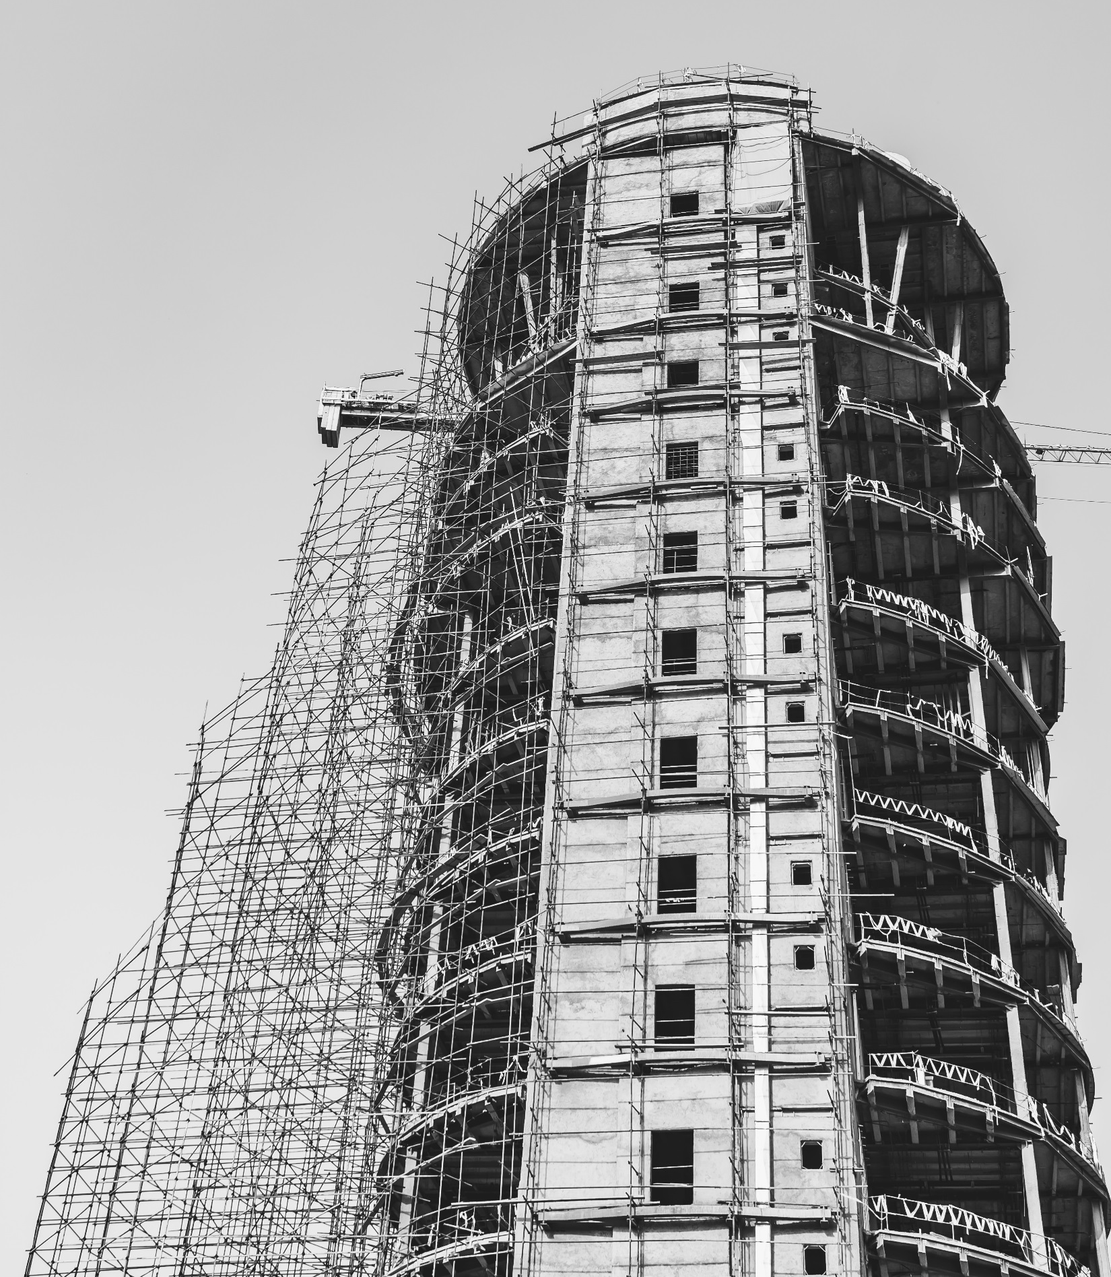
Scaffolds are a temporary form of access used to create a safe working platform at height.
Scaffolds must:
Be the right type for the building
Follow a series of controls
Assess risks and issue clear instructions
Be erected by a team
Use ladders when required
Kate Lindsay @KTDIGITAL
Notes:
When I mention scaffolding at work, students are not the first thing that comes to my colleagues minds. But the definition for scaffolding in construction is not that different.

Slide 7

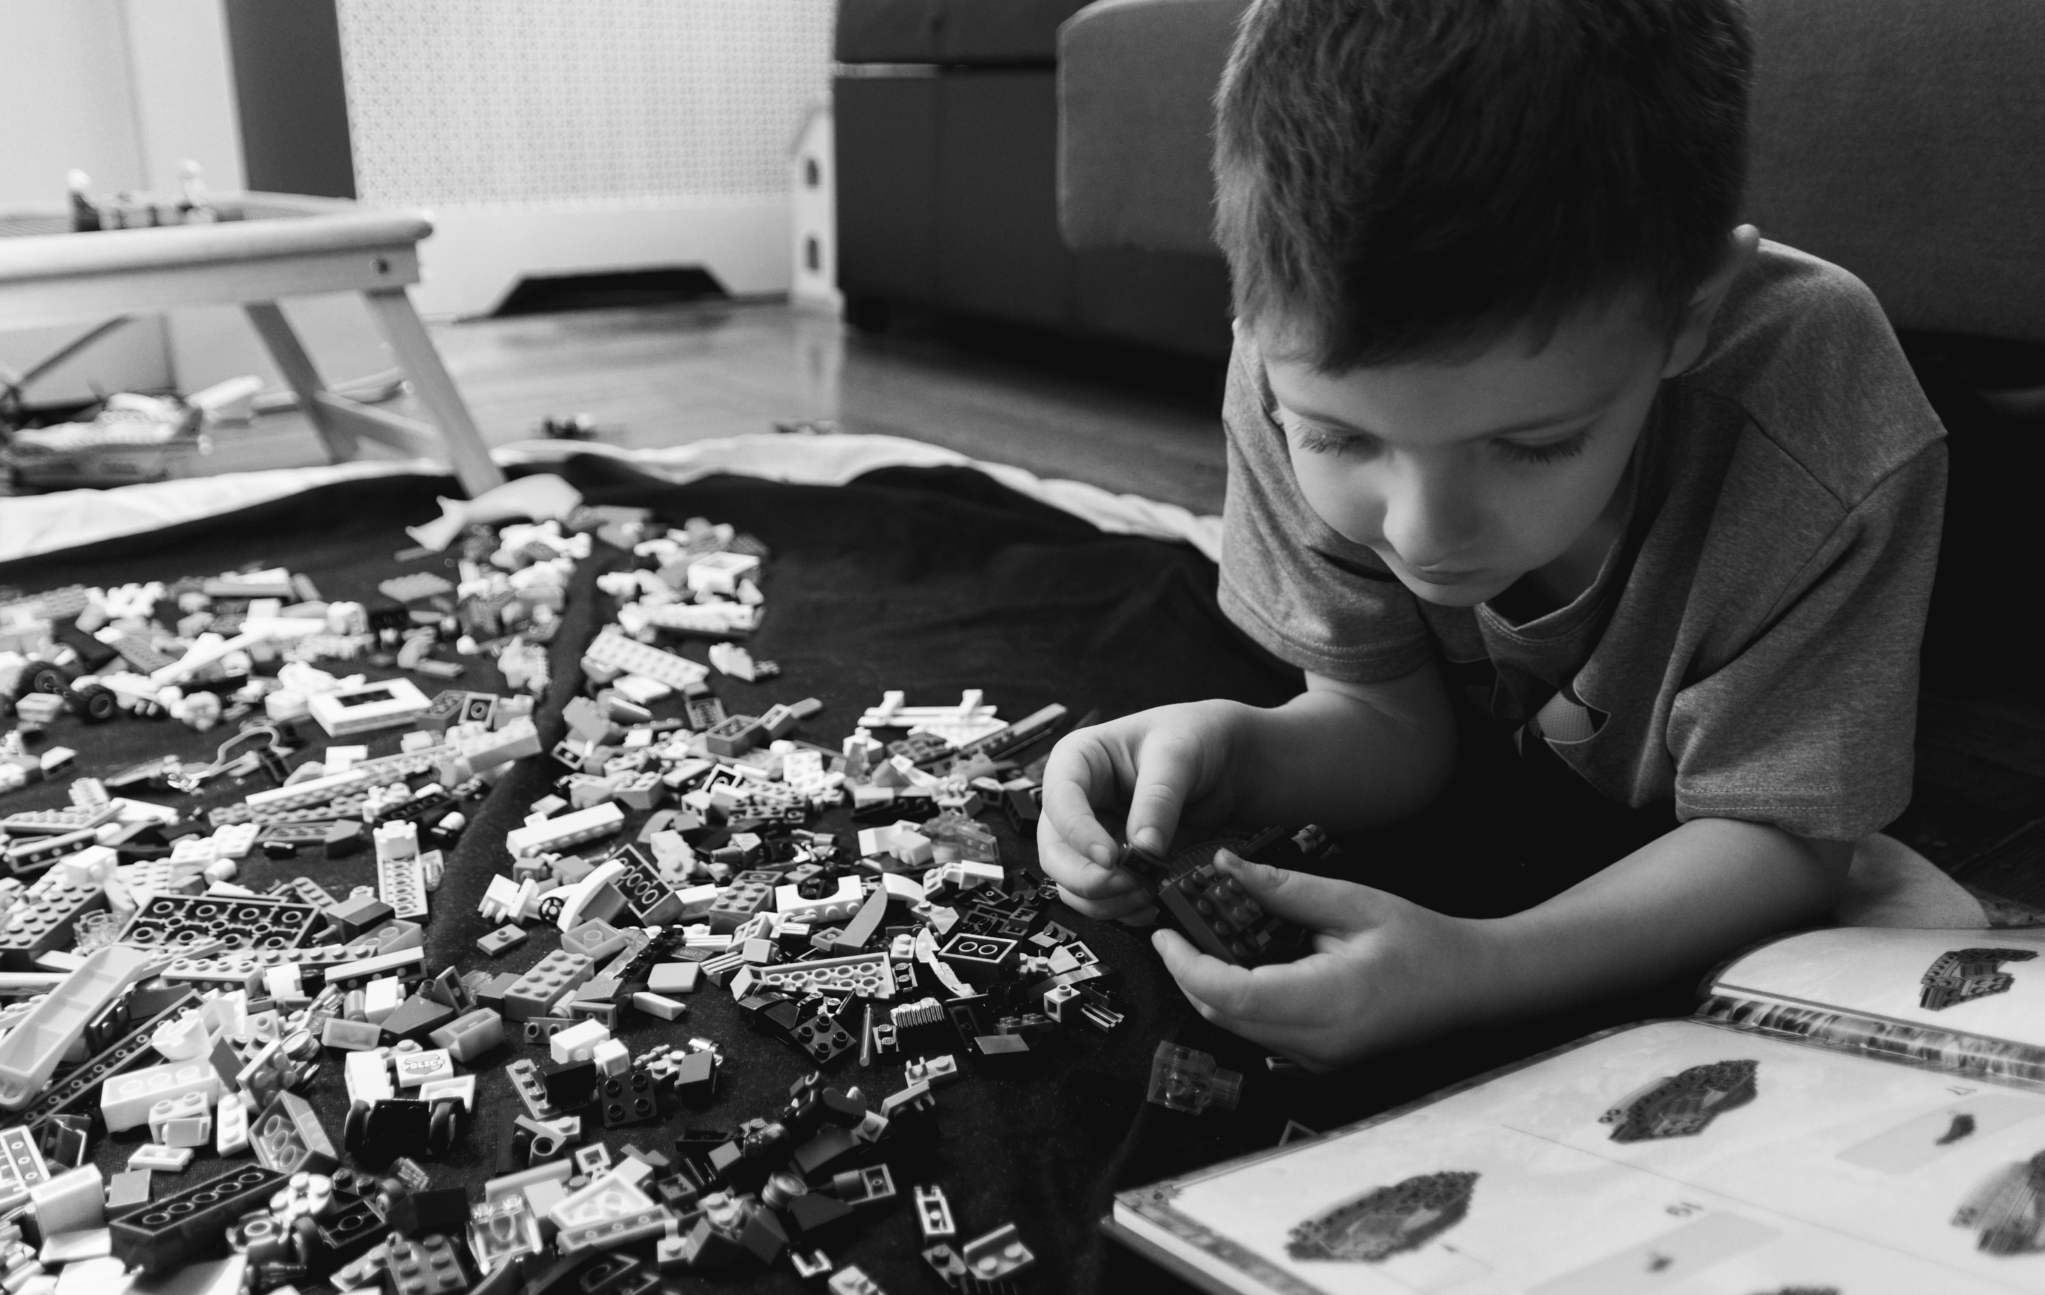


Conceptual
Procedural
Strategic
Metacognitive
Jumaat, Nurul, Farhana & Zaidatun, Tasir (2014). Instructional Scaffolding in Online Learning Environment: A Meta-Analysis
Notes:
In online education 4 main types have been identified.
Conceptual scaffolding: helps students decide what to consider in learning and guide them to key concepts
Procedural scaffolding: helps students use appropriate tools and resources effectively
Strategic scaffolding: helps students find alternative strategies and methods to solve complex problems
Metacognitive scaffolding: assists students reflecting on what they have learnt
Scaffolding can also get in the way of seeing people for who they really are
It’s that building undergoing renovation, you aren’t sure what it’s going to be, how it will interrelate to its surroundings, or how it will become part of a place or community.

Slide 8
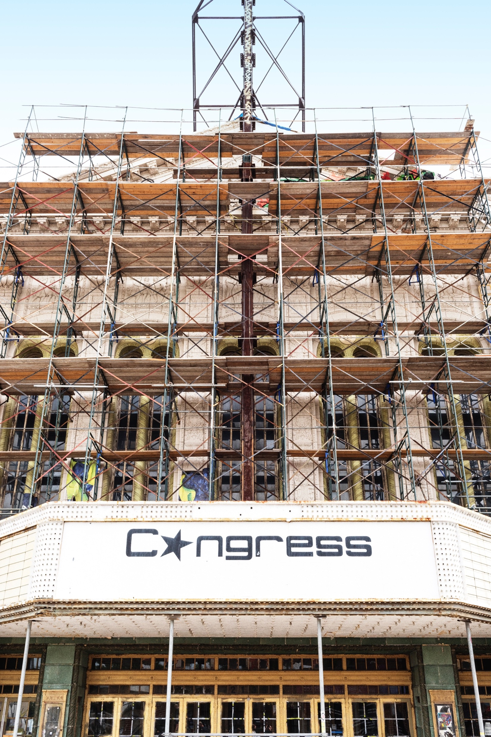
Attrition rates continue to be much higher for online learners than those in face-to-face or blended contexts (Bawa, 2016).
Whilst online provision gives more access to education, once enrolled those learners can find that they are in fact more disadvantaged and that achievement gaps are widened (Moore & Greenland, 2016; Kizalic & Halwala, 2015).
Notes:
I put forwards that no amount of the 4 types of scaffolding mentioned will significantly change this. As it’s not about the person, its about the learning. And the issue with Personal scaffolding is that it is complex to implement at scale, which is what we face with fully online education.
We need to find ways to implement the humanity and support, to reach through the screen – increase ways of engaging, modelling kindness, raising awareness and reflecting on the world around us.

Slide 9
KARE scaffolding person and place
Student outcome led design
Kindness
Awareness
Learning Design Model
Student experience
Pedagogies
Presence
Participatory, authentic, situated, problem-based
Synchronous & asynchronous
Engaged
Reflective
Kate Lindsay @KTDIGITAL
Notes:
For the past year we have been engaged in a process of transforming how we design and provide education to our students, taking into consideration who they are, the challenges they face engaging in their studies and challenges they face within industry.
We have adopted a learning design model that works backwards from the learning outcomes - what is it we want students to be able to do? to ensure all learning is aligned. Assessments are much more scenario-based and reflect real-world applications of knowledge. We provide plenty of opportunities to practice online activities to increase confidence, and design content that the learners can connect to their everyday lives. We have increased opportunities to connect synchrously and asynchrously with tutors and peers, as well as opportunities to receive, give and act on feedback. The pedagogies we are employing are active and participatory to reflect the connected world of the BE industry, they are situated and problem-based to ensure relevance.
– it is clear we need to provide scaffolding that provides support for the person, their engagement with their learning. Scaffolding to become part of an online learning community that can provide support and kindness beyond the capacity an institution can provide, support and kindness at scale. To borrow another analogy from the BE, and to reflect something Sue said yesterday in her keynote – we need to make a place in the digital space.
Our scaffolding models kindness to students – we start from a place of trust,
To create cohesion we support students to develop awareness – if we think of awareness as a set of nested orbs inside each other. The first innermost sphere is instinctual: self-awareness of basic needs, how we feel, how motivate ourselves to work towards goals. Without this awareness, we can’t manage our own feelings and reactions, and we can’t practice kindness to ourselves.
The second sphere is awareness of those people in our immediate context – students and tutors. Ift enables us to support others and to practice kindness. Linked back to self-awareness, we call it empathy.
The third is awareness of the world around us and people we may not have contact with. It can include issues such as caring for our planet, being mindful of diversity and areas we may not have encountered before. I’m thinking of the mental health here.
We ask students to reflect on this growing awareness and consider it in relation to themselves and the work or home environment they are situated in.
Then to help them to use this information they bring it into our digital place and apply it when engaging with peers and undertaking collaborative work.

Slide 10
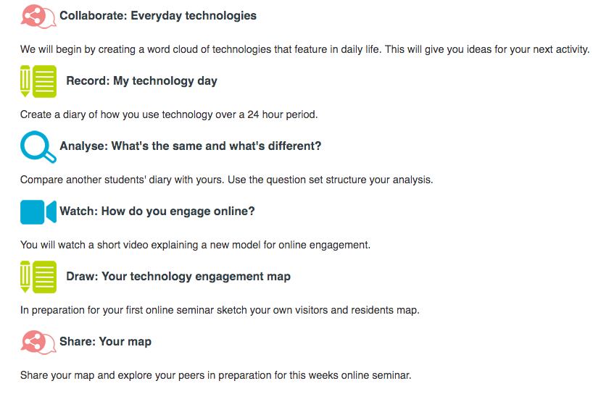
Task 1.2 Technology and you
K Help students get started.
A Learn about different experiences and understand your own
R Examine why some things are different and some the same.
E Opportunity to discuss
Kate Lindsay @KTDIGITAL
Notes:
Ensure that awareness is embedded within the curriculum – professional, human, built environment.
Start with Kindness (understand our students and each other as people)
Then raise Awareness
Then ask for Reflection
Then Engagement

Slide 11
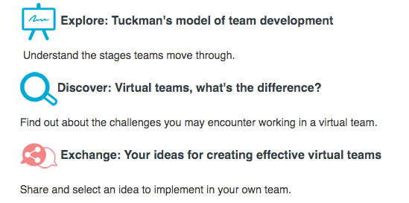
Task 1.1 Working as a team
K Forms part of the assignment.
A Understand some of the challenges of this assignment.
R What can you learn from previous experience.
E Simple first task to undertake as a team
Kate Lindsay @KTDIGITAL
Notes:
Ensure that awareness is embedded within the curriculum – professional, human, built environment.
Start with Kindness (understand our students and each other as people)
Then raise Awareness
Then ask for Reflection
Then Engagement

Slide 12
Scaffolding is a temporary structure, but it needs to remain in place until our work is done.
Thankyou
Kate Lindsay @KTDIGITAL
Notes:
Ladders and scaffolding are different.
Can’t just remove hem and leave folk stranded (which most online instruction presumes) We can make it E.g accordian instructions.
Leave the scaffolding in place and use ladders when we need to
Scaffolding place and presence is fundamental to fully online education.
The design-process is what distinguishes online teaching most from traditional on-ground teaching. When we teach an on-ground class, the room in which we teach has been built for us in advance. Usually, it’s in a school, on a campus, has chairs, desks, tables, windows, walls, a door. Sometimes there’s a computer, a projector, a screen. Hopefully, the desks and chairs are moveable and there are chalkboards on multiple walls. When we enter these rooms, we still make (or, rather, should make) intentional design decisions. How will the chairs be arranged? What direction will we face? Will the blinds be open or closed? Where will the teacher’s desk be? Will the room have a front? Will we re-arrange from day to day or maintain a consistent configuration?
All of these decisions require careful contemplation and experimentation. Letting the default configuration of a classroom dictate how we’ll teach is to allow the bureaucratic (and in this case architectural) trappings of schooling subsume our pedagogies. I’ve taught in many classrooms where the desks were arranged by default into rows, each student forced to stare into the back of another student’s head. This is not a prime configuration to encourage active engagement, critical thinking, collaboration, interaction, making, doing, or discussing, all of which are (in varying degrees) essential for learning. I would say, though, that any arrangement is problematic if it’s fixed permanently in advance. The learning space should be constructed intentionally from one activity to the next and preferably by or in consultation with students.
When we teach online, we have to build both the course and the classroom. A good learning management system is a tool that can help with this process; however, we should never let its design decisions — its architecture — dictate our pedagogies. We should also not blindly follow our institution’s choice of learning management system. Certain tools work well for building certain kinds of learning experiences, but there’s no universal solution. Teachers should be instrumental in making decisions about the technologies used in their classrooms (virtual or otherwise). And a single course should leverage several solutions and configurations, given the specific needs of the day, activity, or student.
Hybrid classes demand an even more complex architecture, requiring consideration of the physical space(s) we’ll work within, the virtual space(s), as well as the various ways we’ll move between the spaces. When we build a hybrid class, we must consider how we’ll create pathways between the learning that happens in a room and the learning that happens on the web. A hybrid strategy can be as simple as a single but powerful hyperlink embedded in an e-mail or as complex as replacing the syllabus for a course with a multi-author WordPress installation.

